Slide 1
Seminar 1 - outline
Converting numbers between numbering bases 2, 10, 16
Representation of integer numbers in the computer’s memory
Introduction to the IA-32* assembly language
*IA-32 – a short for "Intel Architecture, 32-bit", is the 32-bit version of the x86 instruction set architecture, designed by Intel

Slide 2
Conversions
A number is converted from a source base to a destination base.
There are two algorithms that are mostly used for converting a natural number between numbering bases:
first is based upon successive division operations
second is based on successive multiplication operations.

Slide 3
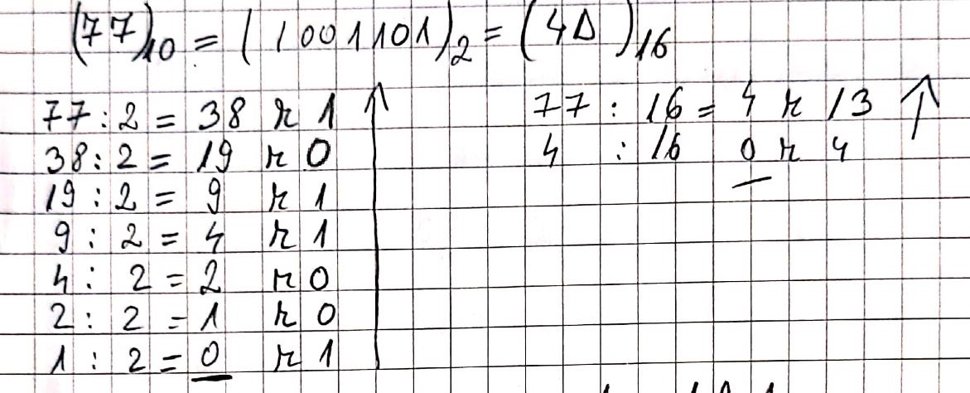
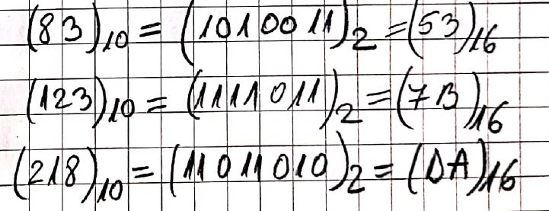
Examples: from base 10 in base 2 and in base 16

Slide 4
The conversion algorithm that uses successive divisions
This algorithm is useful when converting a number from base 10 to another numbering base (because computations are done in the source base; i.e. base 10)
The initial number is continuously divided to the destination base (i.e. the initial number is divided to the destination base, then the obtained quotient (romanian: catul) is divided to the destination base and so on..)
... until we get a zero quotient
The remainders (Romanian: resturile) obtained taken in the reverse order form the representation of the initial number in the destination base

Slide 5
The conversion algorithm that uses successive multiplications
This algorithm is useful when converting a number from base different than 10 to base 10 (because computations are done in the destination base; i.e. base 10)
Considering that the representation of the number in base s is: a_{n}a_{n-1}… a₁a₀, the representation of this number in the destination base d will be computed like this:
a_{n} *s^n + a_{n-1}*s^(n-1) +… +a₁ *s^1 + a₀*s^0 - where computations are done in base d.

Slide 6
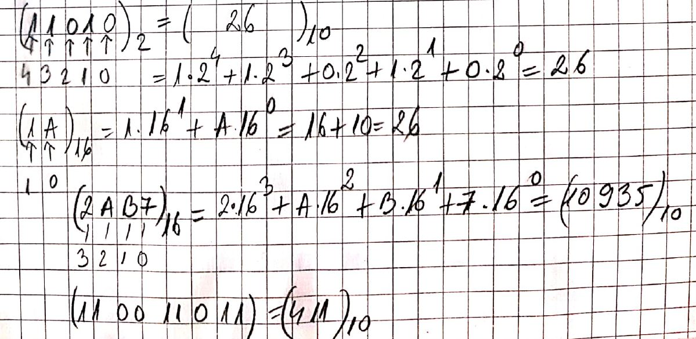
Examples: from base 2 in base 10 and from base 16 in base 10

Slide 7
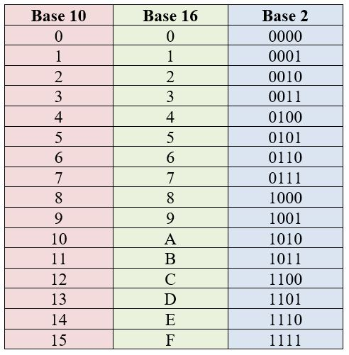
Fast conversions between bases 2 and 16
A digit in base 16 has as a correspondent a group of 4 digits in base 2
To perform a fast conversion from base 16 in base 2, we simply replace each digit from base 16 with the corresponding group from base 2
To perform a fast conversion from base 2 in base 16, we group 4 digits, from right to left and then replace each group with the corresponding digit from base 16
If is necessary we can complete with 0 to the left

Slide 8
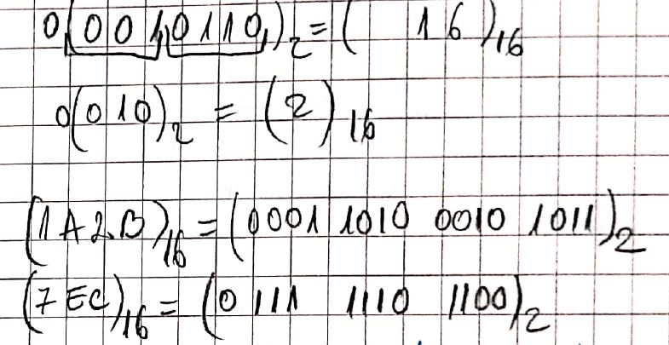
Examples for fast conversions
(0AB34)16 = (?)2
(89DC)16 = (?)2
(1001111)2 = (?)16
(110101110)2 = (?)16

Slide 9
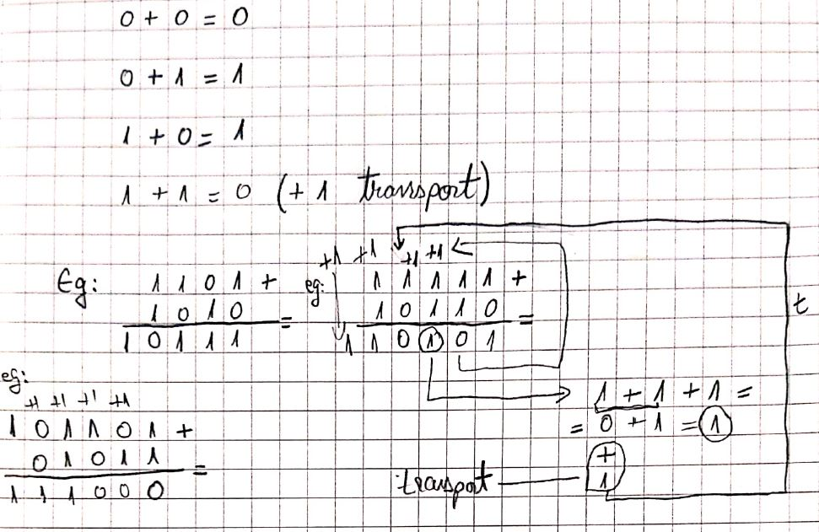
Addition in binary
0101 + 110 =
11101 + 0111 =

Slide 10
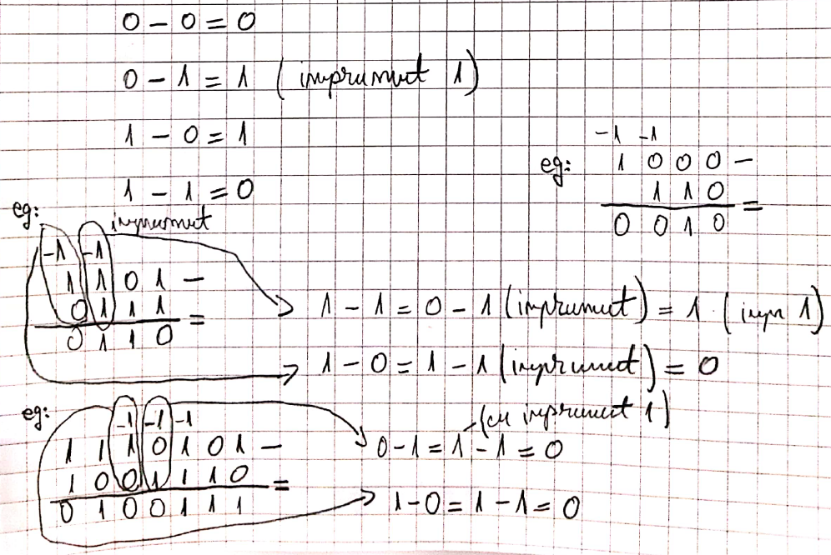
Substraction in binary
011010 – 1110 =
1110101 – 01011 =

Slide 11
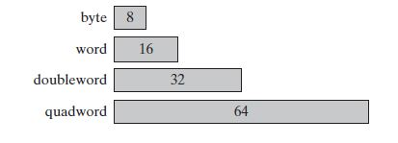
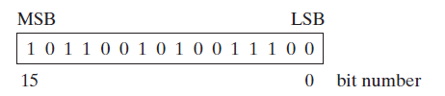
Bit
1 binary digit = 1 Bit (a software concept that represents the smallest quantity of information)
1 Bit has two possible values: 0 or 1
The basic storage unit for all data in an x86 computer is a byte, containing 8 bits.
Next storage sizes are:
word (2 bytes)
doubleword (4 bytes)
quadword (8 bytes)
Bits are numbered sequentially starting at zero on the right side and increasing toward the left.
The bit on the left is called the most significant bit (MSB), and the bit on the right is the least significant bit (LSB).
The MSB and LSB bit numbers of a 16-bit binary number:

Slide 12
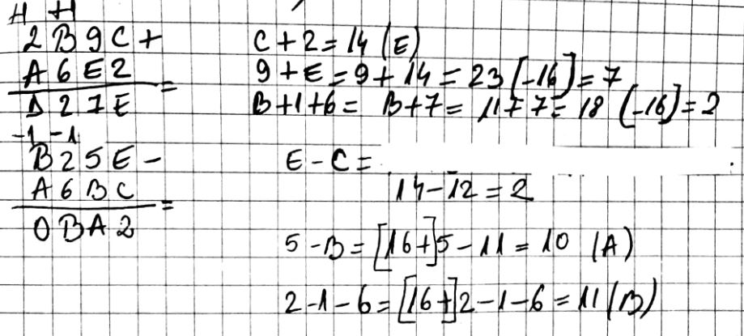
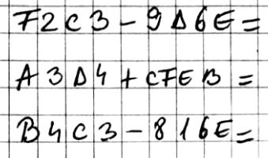
Addition and Substraction in base 16

Slide 13
How does the central processor unit (CPU) represent integer numbers in the memory ?
The CPU represents an integer number on 1, 2, 4 or 8 bytes on the IA-32 architecture (1 byte = 8 consecutive bits).
In fact, there are two kinds of representation of integer numbers in the computer’s memory:
signed representation
unsigned representation
The CPU choses one of these two representations depending on the specific instruction it executes.

Slide 14
Unsigned representation of numbers
in unsigned representation we can only represent positive natural numbers
the unsigned representation of a positive number is equal to the representation of that number in base 2
the unsigned representation of 17 on 8 bits is : 0001 0001
the unsigned representation of 39 on 8 bits is : 0010 0111

Slide 15
Signed representation of numbers
in the signed representation we can represent positive and negative integer numbers:
the signed representation of a positive number is equal to the unsigned representation of that number (it is equal to the representation of that number in base 2)
the signed representation of a negative number is equal to the representation in two’s complementary code (Romanian: codul complementar fata de 2) of that number

Slide 16
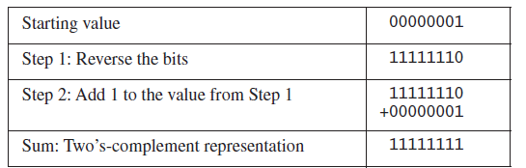
2’s complementary code Computation
1. The two’s complement of a binary integer is formed by inverting its bits and adding (as a sum) value 1.
Using the 8-bit binary value 00000001, for example, its two’s complement turns out to be 11111111, as can be seen as follows:
2. Second way to obtain the 2’s complementary code of a negative number, we can substract the absolute value of the number (Romanian: modulul numarului) from 1 followed by as many zeroes as needed in order to represent the absolute value of the number.

Slide 17
2’s complementary code example
in the signed representation, the most significant bit (i.e. binary digit) of the representation is the sign bit (1=negative number; 0=positive number)
the signed representation of 17 on 8 bits is : 0001 0001 (the most significant bit is 0, so the number is positive)
2: the signed representation of -17 on 8 bits is : 1110 1111 (note that the sign bit is 1 in this case, so the number is negative)

Slide 18
Example: 22
Unsigned representation on a byte: (22)10 = (0001.0110)2
Signed representation:
positive value: (0001.0110)2
negative values [= 2’s complementary code =] (1110.1010)2

Slide 19
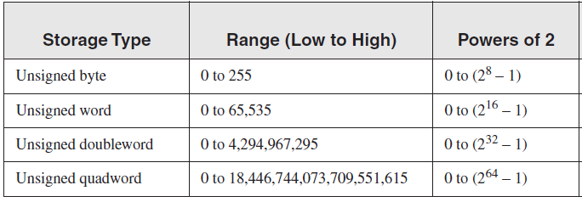
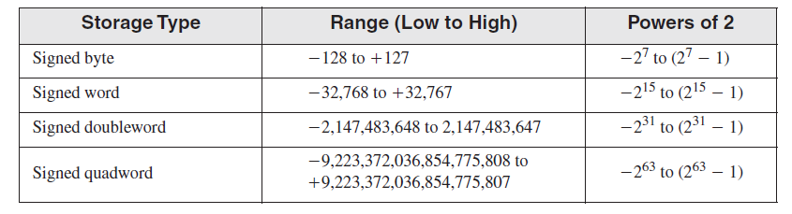
Storage sizes and ranges for unsigned and signed

Slide 20
Introduction to the IA-32 assembly language
The IA-32 is a 32-bit computing architecture (basically meaning that its main elements have 32 bits in size) and it is based on the previous Intel 8086 computing architecture.
An algorithm can be described using the natural language (e.g. romanian language, English language etc.) or it can be described in a programming language (e.g. C, Java, python, php etc.).
When an algorithm is specified in a programming language, we refer to this algorithm as a program.
In a similar way, a program contains:
a) a set of data/entities
b) a set of operations/instructions.

Slide 21
The elements of the IA32 assembly language
We will first describe the data part of the assembly language and then the operational part (instructions).
All data used in an IA-32 assembly program is essentially numerical (integer numbers) and can have 4 basic types:
byte – that data is represented on 8 bits
word – that data is represented on 16 bits
doubleword – that data is represented on 32 bits
quadword – that data is represented on 64 bits
In the IA-32 assembly language we have data that does not changes its value throughout the execution of the program (i.e. constant data or constants) and data that does change its value throughout the execution of the program (i.e. variable data or variables).

Slide 22
Constants
We have 3 types of constants in the IA-32 assembly language:
numbers (natural or integer):
written in base 2; ex.: 101b, 11100b
written in base 16; ex.: 34ABh, 0ABCDh
written in base 10; ex.: 20, -114
character; ex.: ‘a’, ‘B’, ‘c’ ..
string (sequence of characters); ex.: ‘abcd’, “test” …

Slide 23
Variables
The IA-32 assembly language has 2 kinds of variables:
pre-defined variables
user-defined variables.
A variable has a name, a data type, a current value and a memory location (where the variable is stored).

Slide 24
User-defined variables
For these variables, the programmer has to define the name, data type and initial value.
Examples:
a DB 21 ; defines the variable with the name “a”, data type byte (DB-Define Byte) and initial value 21
b DW 34Ah ; defines the variable with the name “b”, data type word (DW-Define Word) and initial value 34Ah
c DD -6 ; defines the variable with the name “c”, data type doubleword (DD-Define DoubleWord) and initial value -6
a3 DQ 00FABCh ; defines the variable with the name “a3”, data type quadword (DQ-Define Quadword) and initial value 00FABCh

